Slide 1


A Presentation On “SANJEEVANI COVID-19 APP ”
GUIDE:
Mr.S.Y.Divekar
Group members:
Mrunal Kshirsagar
Sakshi Shendkar
Kunal Kulkarni
Aditya Thorat
Project co-ordinator:
Prof A .N.Gedam
HOD:
Mr V.N.Kukre
Principal:
S. K. Giram
All India Shri Shivaji Memorial Society’s Polytechnic
Diploma in Computer Engineering (Semester-VI),
Kennedy Road, Near RTO, Pune – 411001

Slide 2
Outline
Introduction
Motivation
Abstract
Problem Statement
Proposed System
Methods & Algorithm
Requirement analysis
Project Development Plan
Advantages and Applications
Conclusion
References
Certifications

Slide 3

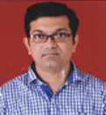

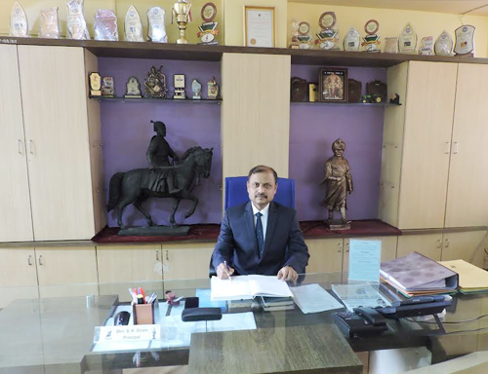
Acknowledgements
Prof. S.Y.Divekar Lecturer at AISSMS Poly
Prof. A.N.Gedam Lecturer at AISSMS Poly
Prof.Vijay N.Kukre HOD at AISSMS Poly
Shri. S. K. Giram Principal at AISSMS Poly
The satisfaction that accompanies that the successful completion of any task would be incomplete without the mention of people whose ceaseless cooperation made it possible, whose constant guidance and encouragement crown all efforts with success.
We are grateful to our project guide Prof. S.Y.Divekar, project coordinator Prof A.N. Gedam for the guidance, inspiration and constructive suggestions that helpful us in the preparation of this project. We also thank our colleagues who have helped in successful completion of the project
We are also glad to express our gratitude and thanks to all the faculty members of our Department, HOD Mr.Vijay N.Kukre, Principal Shri. S. K. Giram and our parents for their constant inspiration and encouragement.
Finally, before ending we would like to express once again our gratitude and thanks to all those who are involved directly and indirectly in making our project a success.

Slide 4
Introduction
As we all know first this virus was discovered in China in November 2019 and unfortunately started spreading all over the world. On July, 2020, more than 17M cases of COVID-19 were reported. This COVID-19 situation is listed as the pandemic by the WHO (World Health Organisation). But along with the rise of COVID-19 cases, there are lot of applications create by lot of COVID-19 warriors. So we have also created an Android application which gives information about the cases and the COVID situation to spread awareness about this pandemic situation. On January, 2020, the first case of coronavirus was discovered in India. All the corona warriors (Doctors, Nurses, Police Officers, Army Officers, Workers, Sweepers, etc) even me and you are fighting against this virus, so we decided to contribute from our side in this fight against corona virus. Hence we created an Android Application which can provide all the information about the active cases, total confirmed cases, total death, total diseased people, and total people who fought against this virus and had won the fight (recovered people). This app shows the above mentioned details of our country (India) and the foreign countries too. Even this application shows the state wise information. All the symptoms and the steps to take against the corona virus is available in the application even in Hindi language just to overcome the language barrier. Red zone areas and the helpline numbers are available of all the states of India. These all features are very useful to our user to stay aware of this COVID-19 pandemic.

Slide 5

Motivation
In this pandemic situation, our covid warriors means the Doctors & Nurses are giving their best to save our lives, in the situation of lockdown Police & Army officers are doing 24 hours of duty for our safety, the Sweepers & Maids are contributing to keep hygiene around us, even Social workers are coming forward to help the needy and poor people.
The above mentioned warriors are doing their respective jobs consistently with all open heart humanity and this is the one thing which has motivated us to do something for society by using our knowledge.
So we got inspiration from them and thought as a future Computer Engineer to do something which will contribute a little to our society and hence developed an easy to use and flexible android application that is Covid-19 App.

Slide 6
ABSTRACT
This app provides the information about the COVID-19 cases, the confirmed cases, the total deaths, total recovered patients and the active cases in our country (India).
This app shows the above mentioned details of our country (India) and the foreign countries too. Even this application shows the state wise information.
All the symptoms and the steps to take against the corona virus is available in the application.
Red zone areas and the helpline numbers are available of all the states of India. This application provides the live information of cases in numbers.
With this application the people will get aware of the situation and even they can check whether they are in the red zone area by searching in the application.
The users can see the active cases, total confirmed cases, total death, total diseased people, and total people who fought against this virus and had won (recovered people) of all the states in India and even get helpline numbers of all the states.
We have created this very simple and straight forward application which make it very easy to use and its UI is user friendly easy to understand. All the provided information is perfect and accurate. The information provided in the application is taken from WHO (World Health Organisation).

Slide 7
Problem Statement
The rapidly evolving nature and severity of the COVID-19 pandemics, new approaches towards safety, risk mitigation, to stop the spread, to let everyone not get mislead by knowing the fake count of patients ,to get over the language barrier and last to reduce the health system burden.

Slide 8
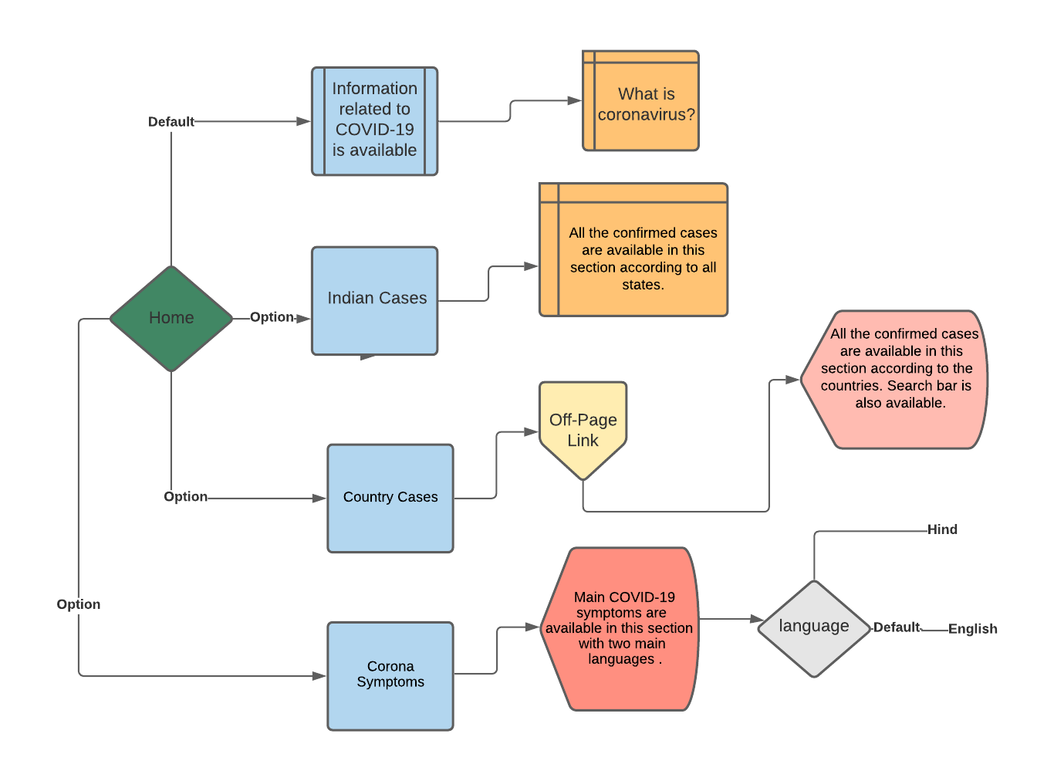
Proposed System

Slide 9
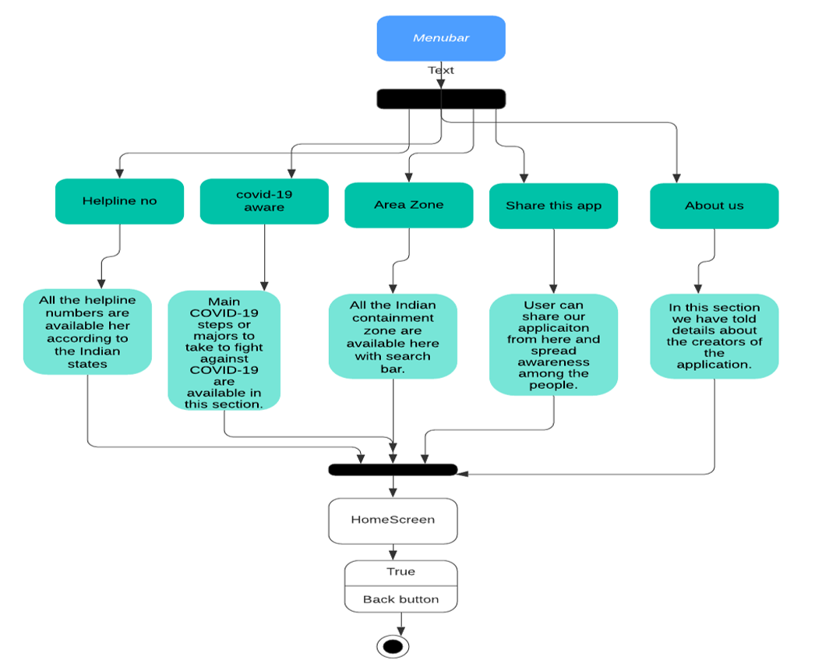

Slide 10
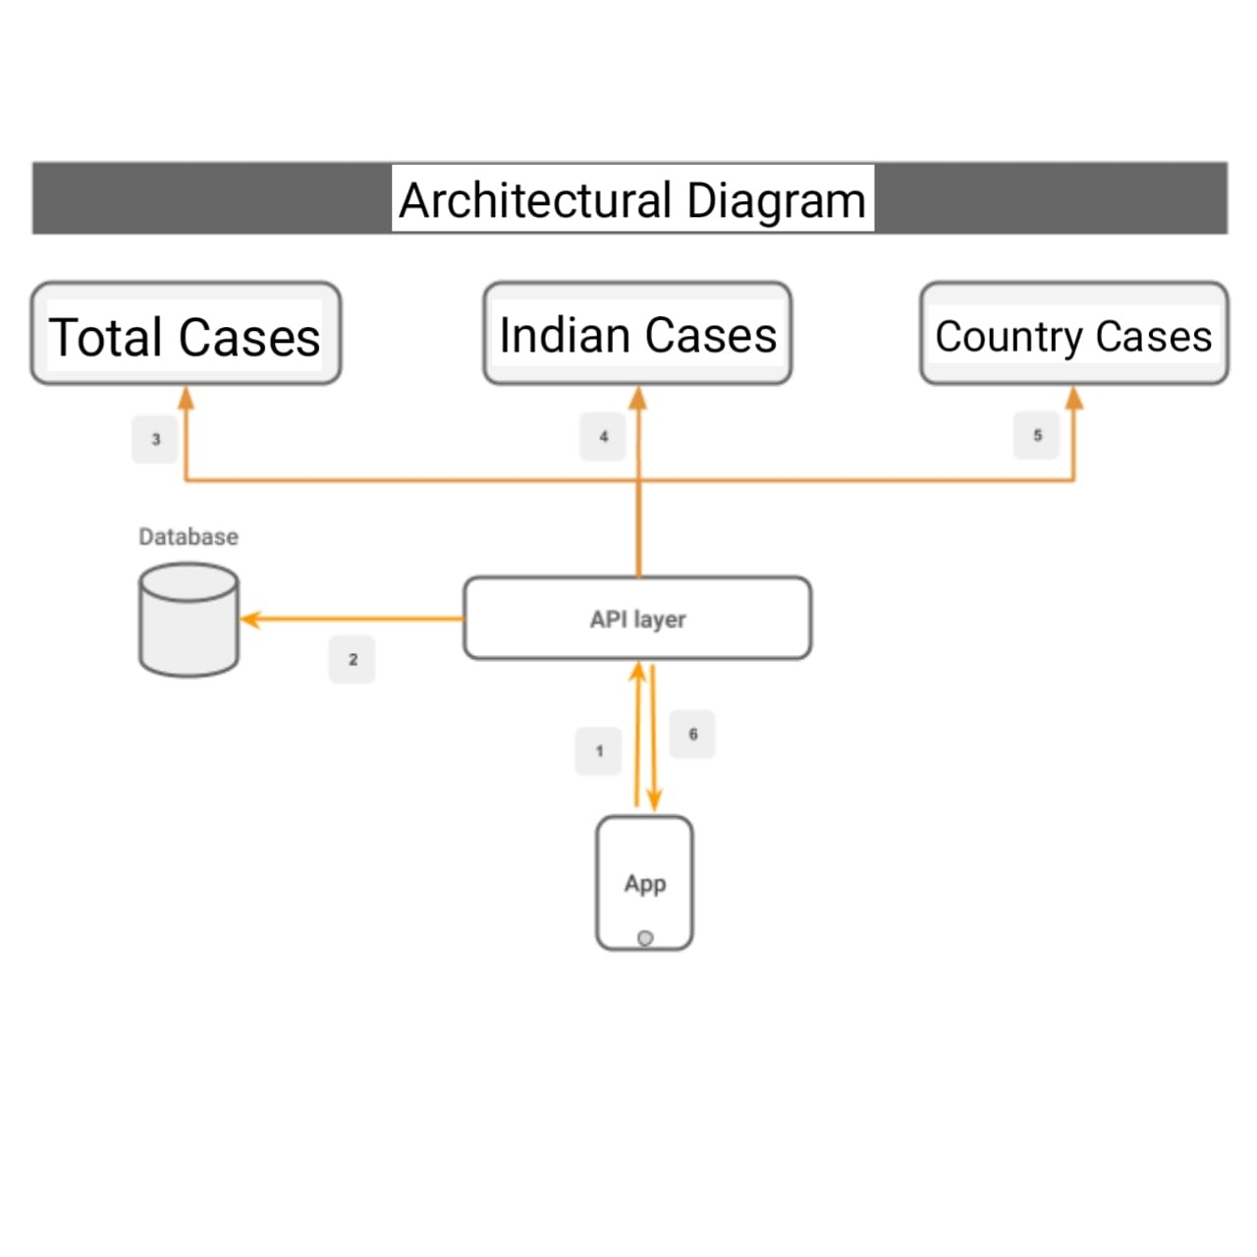
Architectural Diagram

Slide 11

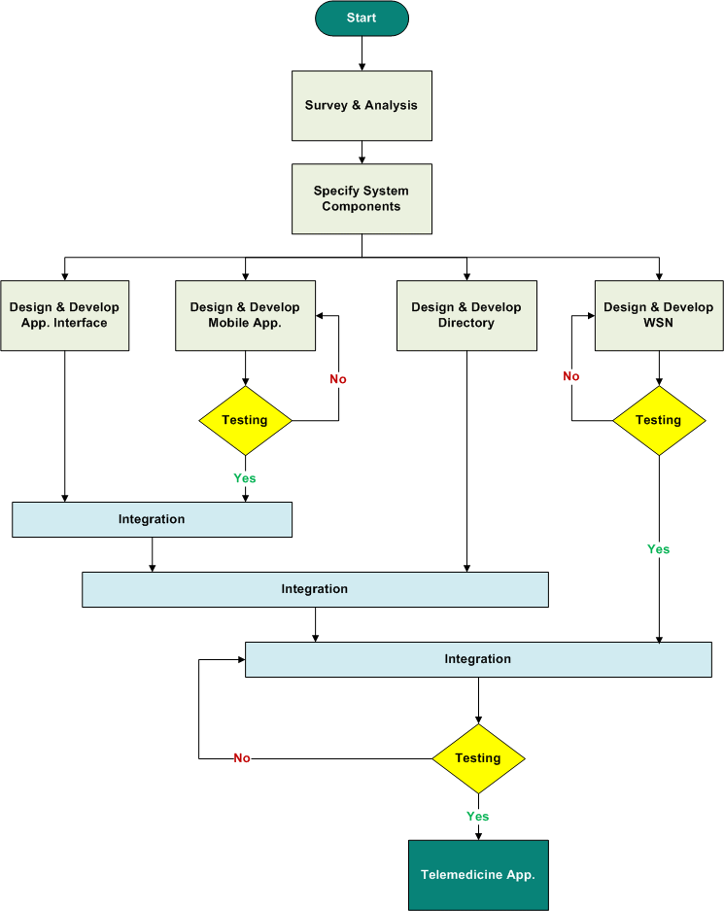
Flowchart

Slide 12
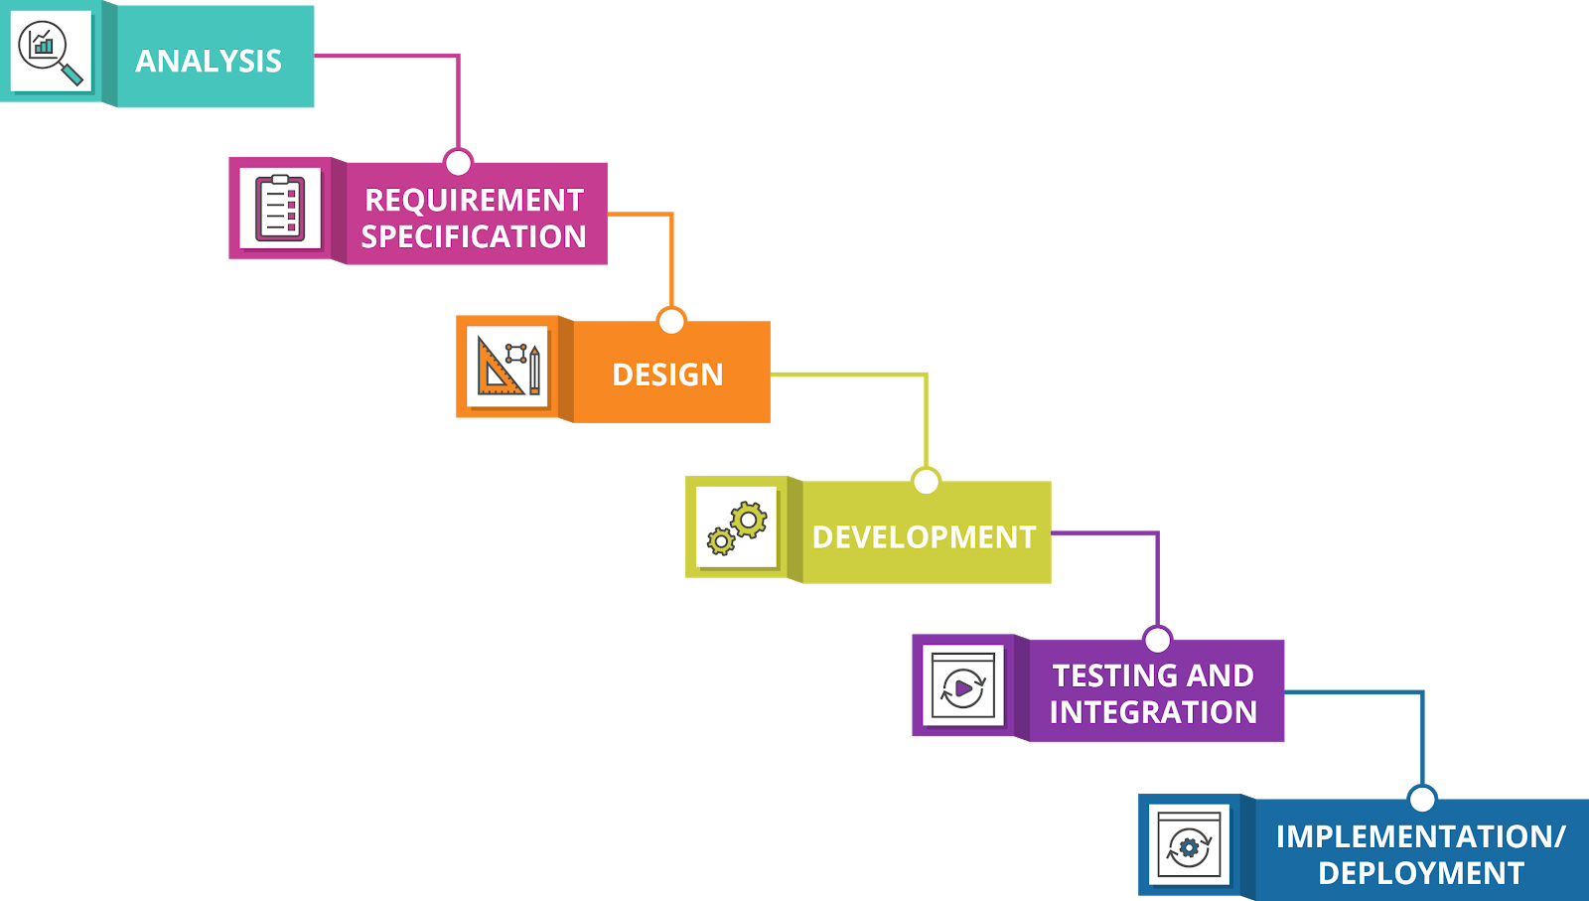
Waterfall model

Slide 13
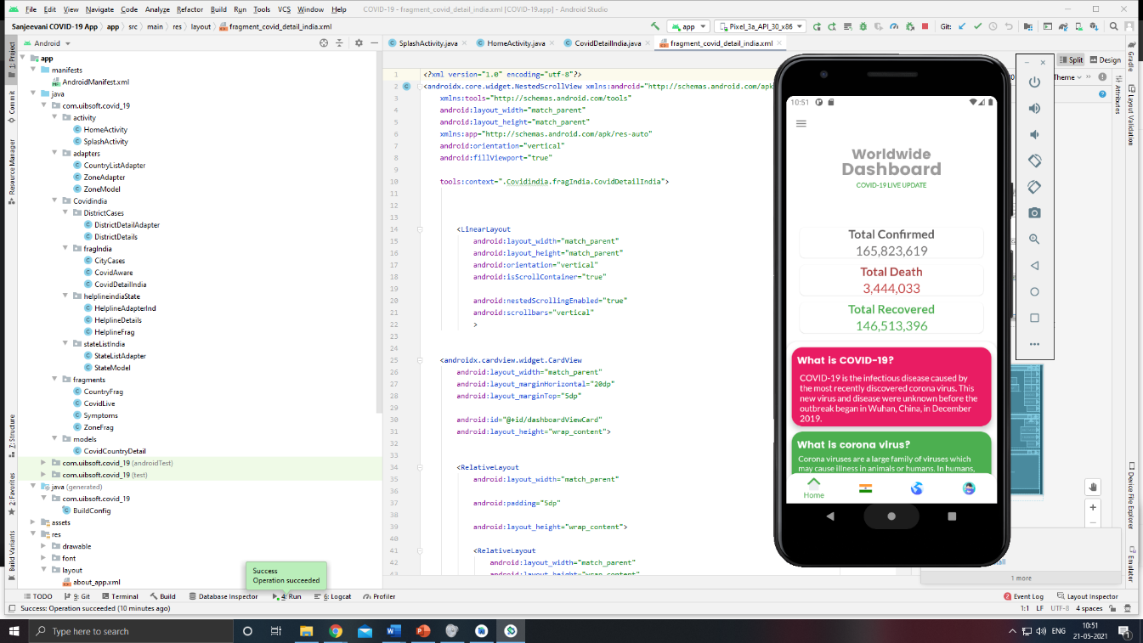
Outputs
The working of Sanjeevani Covid-19 Application is:
You have to install the app on your device
After the installation it will first show the covid info screen with animation the default app screen is Worldwide Dashboard COVID-19 LIVE UPDATE that is the total confirmed, death and recovered patients. Here even answer to the question what is COVID-19 is seen

Slide 14
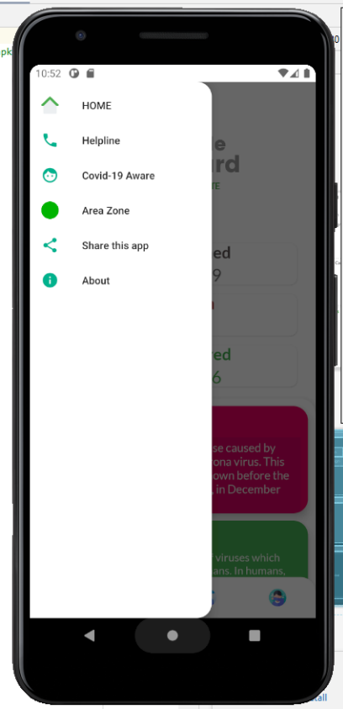
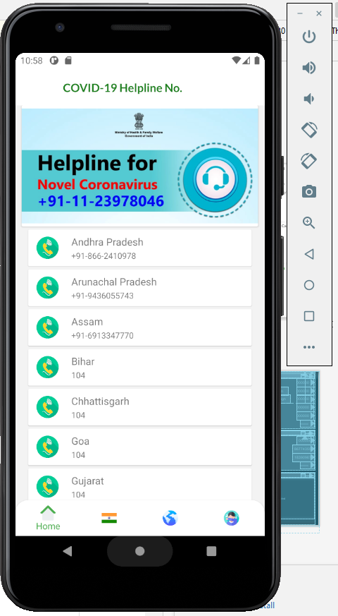
Then if you click on the menu bar which is at top left corner you will be able to see the list of actions like Home, Helpline, Covid-19 Aware, Area Zone, Share app and About which will open that particular page
Example: Here, the second output shows us the helpline number

Slide 15
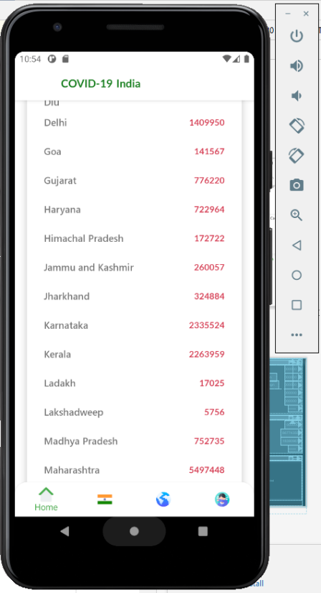
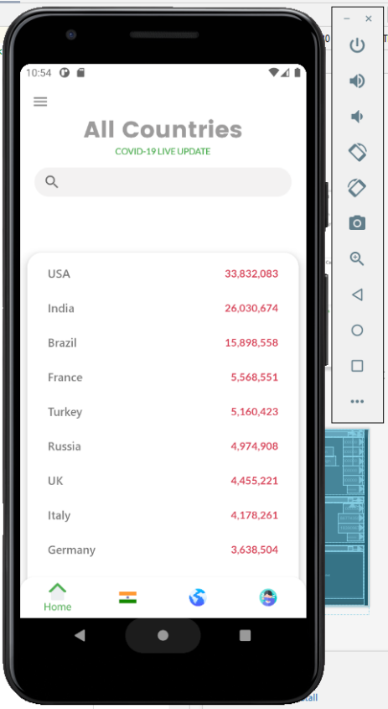
The state and country wise accurate data is displayed
Even we are able to search the particular country we want from the list provided

Slide 16
The Red Zone Areas where we can search , safety measures along with animation effects and symptoms are displayed even in Hindi language to avoid the language barrier.

Slide 17
Methods & Algorithm
Building Project in android studio
Step1: Opening a new project.
Step 2: Before going to the coding section first you have to do some pre-task. Go to app->res->values->colors.xml section and set the colors for your app.colors.xml
Go to Gradle Scripts->build.gradle (Module: app) section and import following dependencies and click the “sync Now” on the above pop up.
Go to app->manifests->AndroidManifests.xml section and allow “Internet Permission“.
Step3: Designing the UI
Step4: Working with Main_ Activity file.
Step 5: Build the project

Slide 18
Requriment Analysis Hardware requirements for development of project :
Sr.No | Resource | Configuration
1 | Processor | Intel i7 core
2 | Speed | 1.1 GHz
3 | RAM | 4 GB
4 | Hard Disk | 25 GB 4
5 | Key Board | Standard Windows Keyboard
6 | Mouse | 7 Two or Three Button Mouse
7 | Monitor | SVGA

Slide 19

Software requirements for development of project :
Sr. No. | Resource | Configuration
1. | Operating System | Windows 10
2. | Coding Language | Java
3. | Software | Android studio 4.1

Slide 20
Project Development Plan
Selecting the topic.
Collection of information on the topic.
Group discussion for designing the project.
Distributing work among team members.
Making PPT and Programs on the given topic.
Rearranging the Data.
Submission

Slide 21
Advantages and Applications
Provides information about this pandemic situation of COVID 19 like the confirmed case, active case, patients discharged and total deaths in our country and even it provides the information of all the states.
Combats the second and third waves of the COVID-19 by providing accurate aggregated data to help inform policy decisions.
Provides accurate and updated information of the no. patients all over the world.
Helpline numbers can be quickly accessed.
It can easily and quickly be deployed for all future pandemics and epidemics.

Slide 22
Conclusion
The this application provides the information of active cases, total confirmed cases, total death, total diseased people, and total people who fought against this virus and had won (recovered people) of all the states in India, and along with it this application also shows information about the other countries (example: USA, Afghanistan, Brazil, etc).
As this application is particular built for the Indian user so, this app also shows the red zone areas in India. The symptoms of corona virus are also available, even the majors or the steps to take against corona virus are also shown . All the helpline numbers are also provided in this application according to the states.
It can also be concluded that it is a promising application that can help people to be safe from coronavirus. The application has useful features and impressive architecture. Even the user interface (UI) is beautiful that user-interactivity was properly kept in mind during the development of the application. So as overall, this application is complete pack of all the important information needed for an individual user.

Slide 23
References
1] Rajan Gupta, Manan Bedi, Prashi Goyal, Srihti Wadhera. Analysis of COVID-19 Tracking Tool in India: Case Study of Aarogya Setu Mobile Application. Digital Government: Research and PracticeAugust 2020 Article No.: 28 https://doi.org/10.1145/3416088
2] Coronavirus disease 2019 (COVID-19): situation report – 78. World Health Organization. 2020. Apr 07, [2020-07-01]. https://www.who.int/docs/default-source/coronaviruse/situation-reports/20200407-sitrep-78-covid-19.pdf
3] MUHAMMAD NAZRUL ISLAM 1, IYOLITA ISLAM 2, KAZI MD. MUNIM 3 AND A. K. M. NAJMUL ISLAM 4,”A Review on the Mobile Applications Developed” for COVID-19: An Exploratory Analysis VOLUME 8, 2020 August 19, 2020. A review on the mobile applications developed for COVID-19: An exploratory analysis (arxiv.org)
4] The Government of India. 2020. Live updates from Worldometer. Retrieved from India COVID: 29,273,338 Cases and 363,097 Deaths - Worldometer (worldometers.info)
5] NBC News. How contact tracing could use Bluetooth to track coronavirus on your smartphone. Available online:https://www.nbcnews.com/tech/tech-news/how-contact-tracing-could-use-bluetooth-track-corona virus-your-smartphone-n1187796

Slide 24
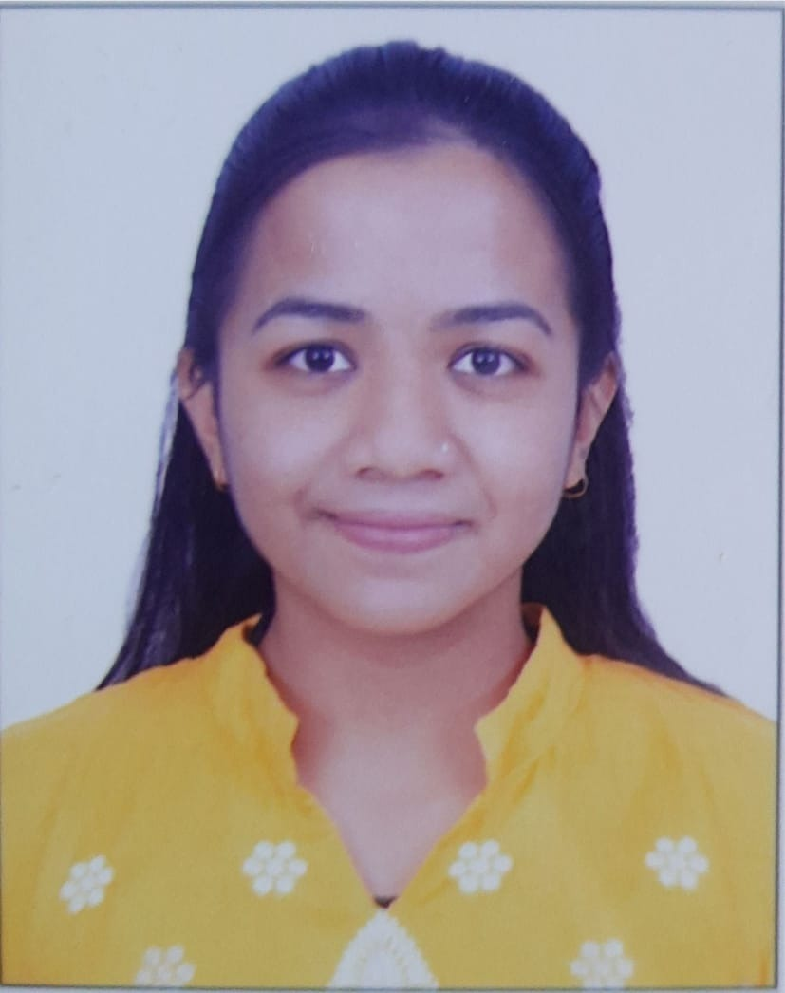

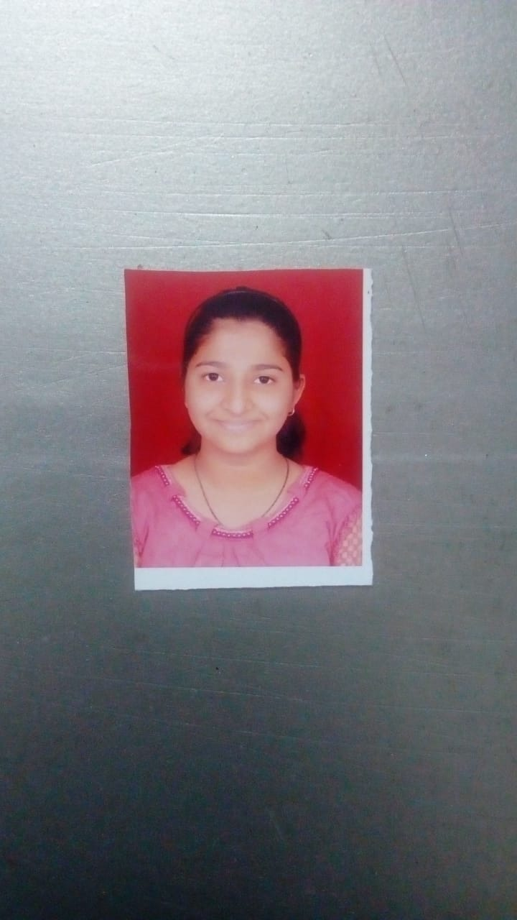

Our Team
Mrunal Kshirsagar
Kunal Kulkarni
Sakshi Shendkar
Aditya Thorat

Slide 25
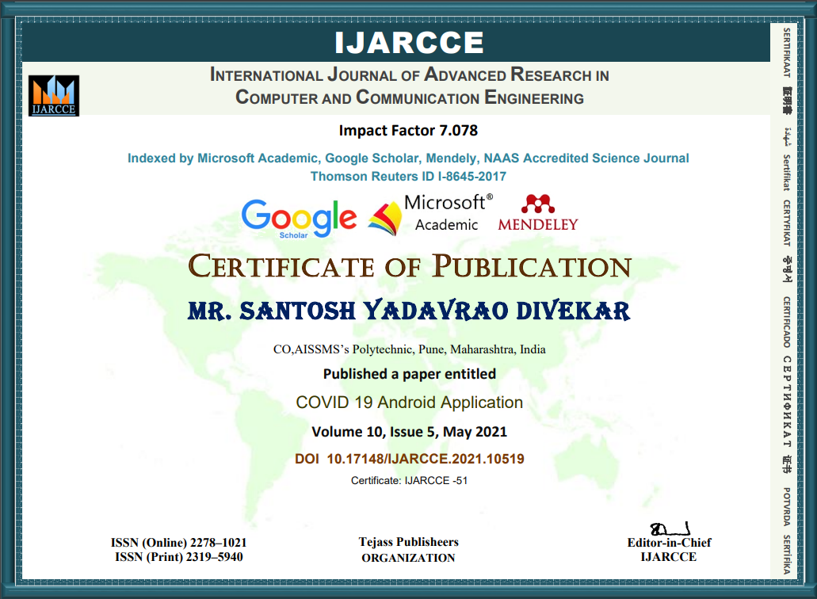
CERTIFICATIONS
Implementation Paper Certificates

Slide 26
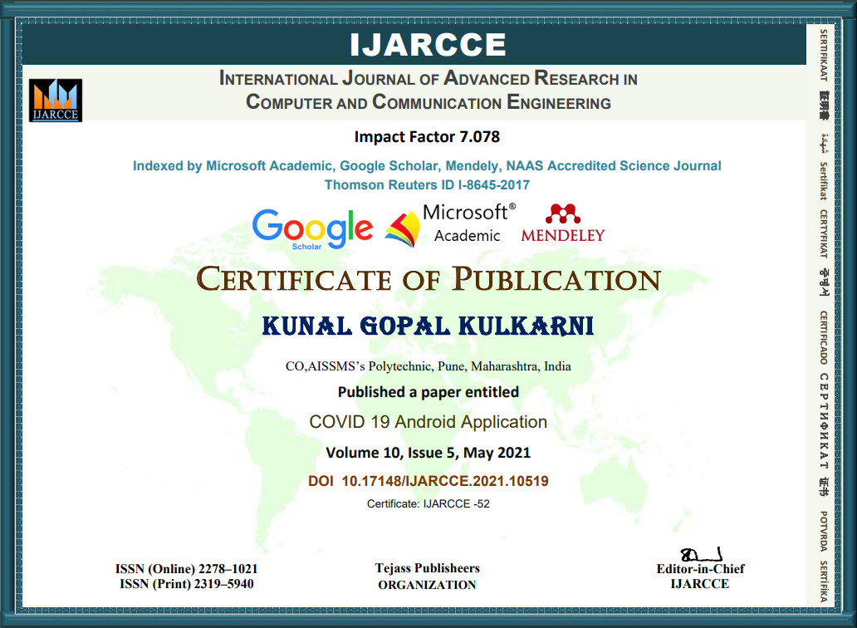

Slide 27
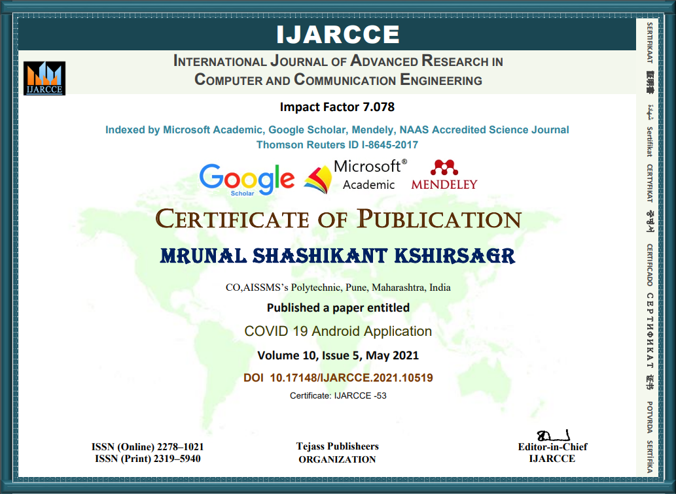

Slide 28


Slide 29

Website Link: https://ijarcce.com/wp-content/uploads/2021/05/IJARCCE.2021.10519.pdf

Slide 30
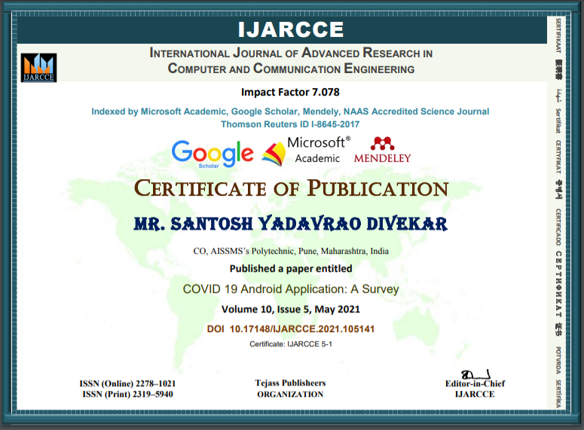
CERTIFICATIONS
Survey Paper Certificates

Slide 31
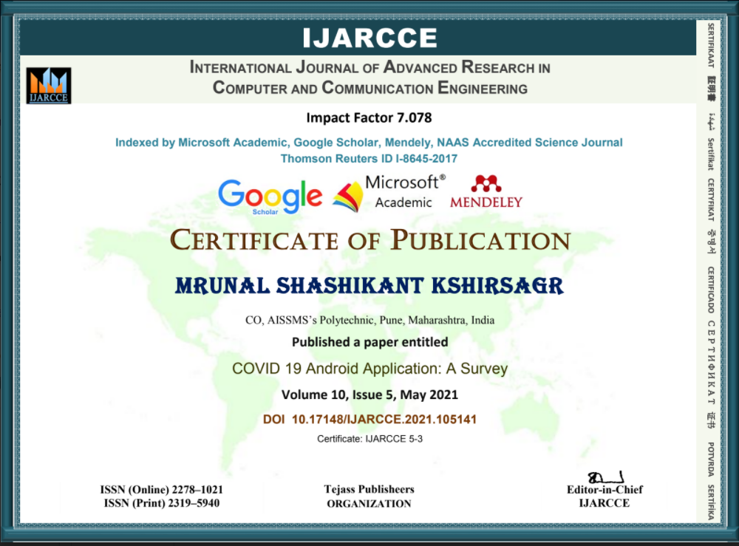

Slide 32


Slide 33
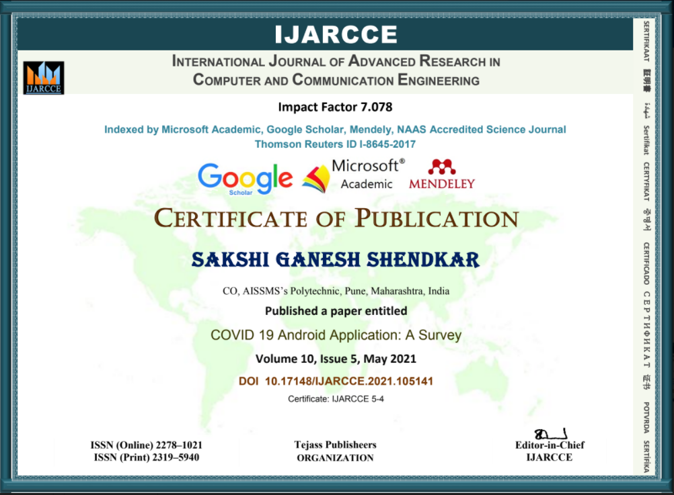

Slide 34

Website Link: https://ijarcce.com/wp-content/uploads/2021/06/IJARCCE.2021.105141.pdf

Slide 35

THANK YOU

